Slide 1

Wireless Network Topologies
Understanding, Types, and Significance
Presented by: Rabi Sah Ritu Dhakal Aashutosh Koirala Bimal Lal Kunwar

Slide 2
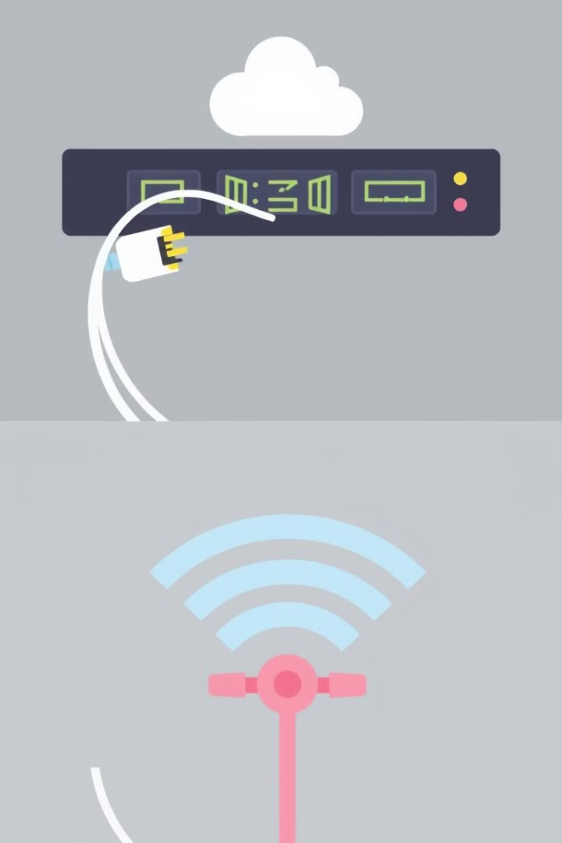

Introduction to Wireless Topology
What is Network Topology?
Two Main Categories
Wired topologies use physical cables, while wireless topologies use radio signals for device communication.
A network topology defines the arrangement and communication patterns of devices, or nodes.
Focus of This Presentation
We will concentrate on wireless topologies, which are vital for modern flexible and mobile networking environments.

Slide 3
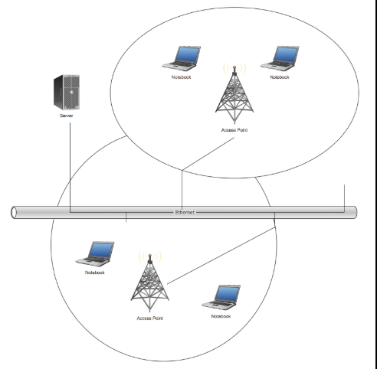
What is Wireless Topology?
Definition
Wireless topology refers to how wireless devices are organized and how they communicate using radio frequencies instead of cables.
This allows devices to connect flexibly without physical constraints.
Benefits
Mobility for users across various locations
Simpler setup without wiring complexity
Widely used in Wi-Fi networks, cellular systems, and IoT ecosystems

Slide 4

Types of Wireless Topologies
Infrastructure Topology
Ad-Hoc Topology
Mesh Topology
Devices communicate through a central Access Point.
Devices connect directly without a central router.
Nodes connect with multiple other nodes creating multiple communication paths.
Hybrid Topology
Star Topology
Combines features from multiple topologies for flexibility.
All nodes connect independently to a central hub or node.

Slide 5
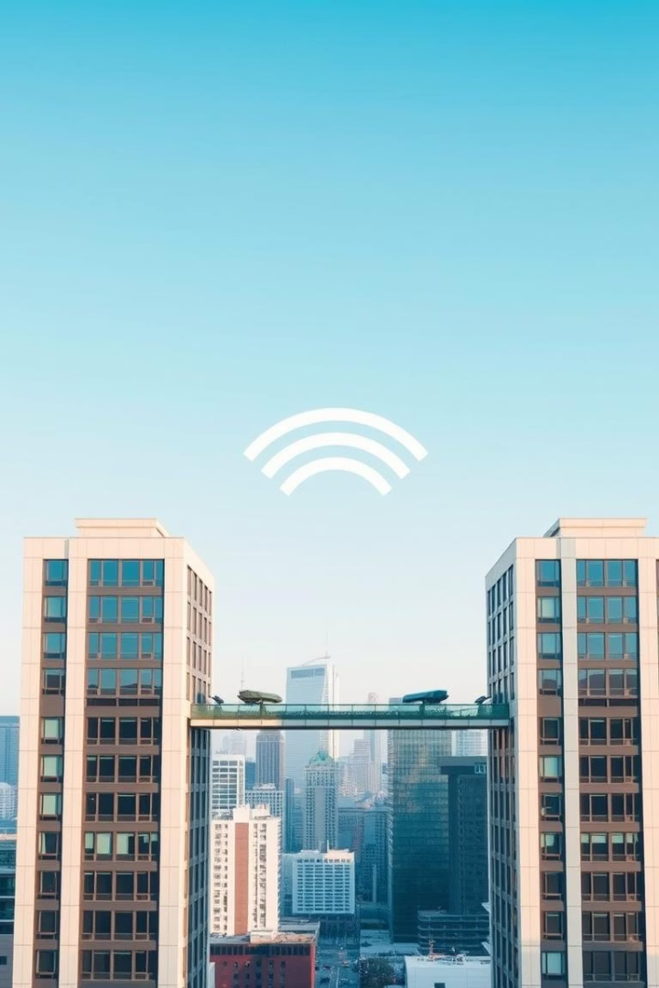
Point-to-Point (PtP) Topology
Dedicated Link
Direct connection between two nodes ensures exclusive communication.
High Speed & Security
Up to 100 Gbps with inherent encryption meeting HIPAA/PCI standards.
Use Case
Building-to-building links, like HQ to backup data centers, use wireless bridges for secure data transfers.
Example Device
Ubiquiti AirFiber 60 LR: 5 GHz, 1.5+ Gbps, over 25 km range.

Slide 6
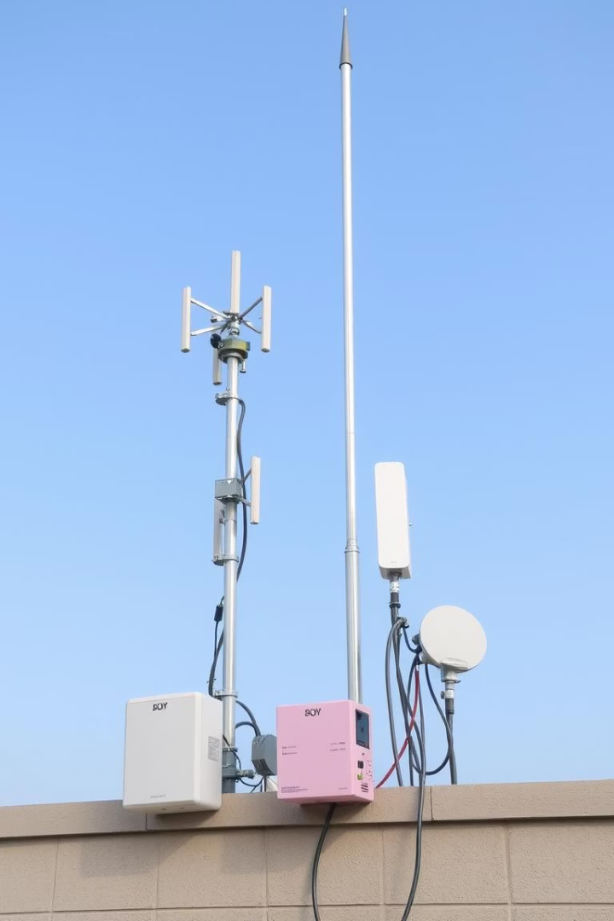
Point-to-Multipoint (PtMP) Topology
Centralized Communi-cation
Typical Usage
Technology
Example Equipment
ISPs use PtMP outdoors for long-range internet delivery to dispersed users.
Directional antennas focus signals improving coverage and capacity.
Cambium Networks PMP 450m: 3 GHz, up to 3 Gbps sector capacity, 10+ mile range.
One device connects and manages multiple endpoints efficiently.

Slide 7


Infrastructure Topology
Common Usage
Device Communication
Widely implemented in homes, offices, schools, and public hotspots for reliable connectivity.
Central Access Point
Clients like laptops and smartphones send data via the AP, not directly to each other.
All devices communicate through a single access point such as a wireless router.

Slide 8
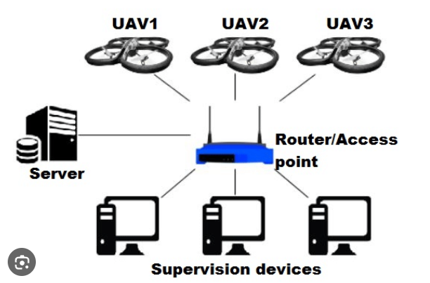

Slide 9
Infrastructure Topology: Advantages & Disadvantages
Advantages
Disadvantages
Centralized management simplifies network control
Network depends heavily on the access point; failure means total outage
Supports large numbers of users simultaneously
Enhanced security through controlled access
Range limited to access point's signal coverage area
Potential bottleneck if many devices connect simultaneously

Slide 10


Ad-Hoc Topology
Direct Device Connection
Device Role
Each device functions as both sender and receiver, enabling flexible interactions.
Devices connect peer-to-peer without intermediary routers or APs.
Use Cases
Ideal for spontaneous networks such as disaster relief, military, or quick file sharing.

Slide 11
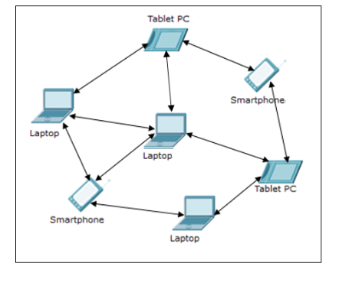

Slide 12

Ad-Hoc Topology: Advantages & Disadvantages
Advantages
Disadvantages
Quick and effortless deployment in various environments
Limited security measures and controls
Weak scalability and coverage for large networks
Operates independently of existing infrastructure
Unsuitable for sustained or complex network needs
Cost-effective as it eliminates access point hardware

Slide 13
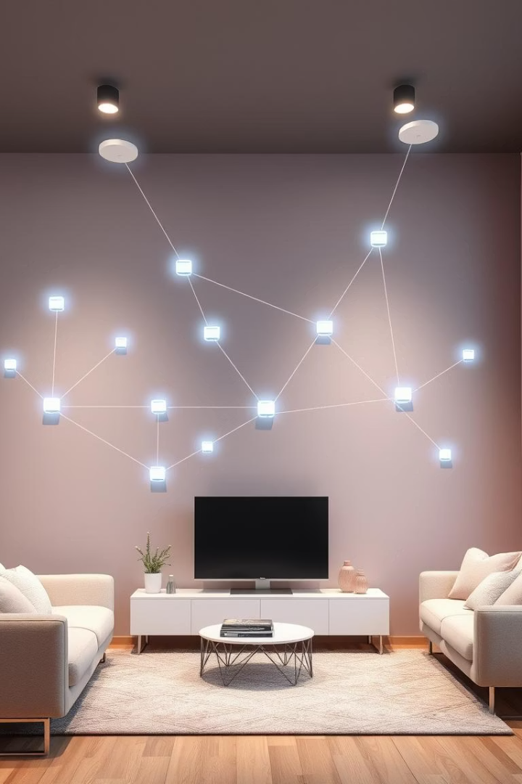
Mesh Topology
Multiple Connections
Each node links to several others, creating a web of pathways.
Self-Healing
Network reroutes traffic if paths fail, enhancing reliability.
Applications
Used in smart homes, industrial environments, and city-wide Wi-Fi deployments.

Slide 14
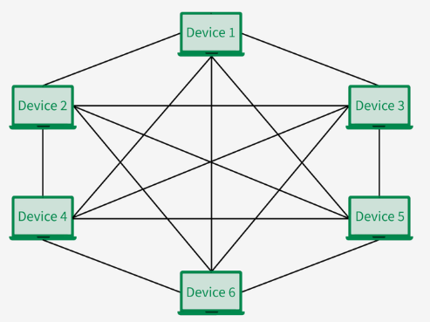

Slide 15

Mesh Topology: Advantages & Disadvantages
Advantages
Disadvantages
Exceptional fault tolerance and network reliability
Complexity in network setup and ongoing management
No single point of failure enhances uptime
Effective for broad-area wireless coverage
Higher costs due to multiple interconnections and hardware
Requires advanced, capable devices for routing duties

Slide 16


Star Topology (Wireless)
Central Access Point
Device Communication
All devices connect via single wireless hub
No direct device-to-device linkage
Common Uses
Homes, cafes, small businesses

Slide 17
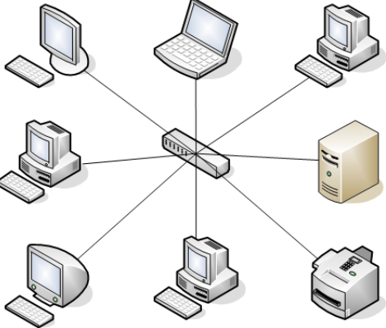

Slide 18



Star Topology: Pros & Cons
Advantages
Simple setup and expansion
Easy management and troubleshooting
Single device failures don’t disrupt network
Disadvantages
Access point is a single point of failure
Performance depends on AP capacity

Slide 19

Hybrid Topology Overview
Combination
Mixes infrastructure, mesh, and other topologies
Use Cases
Universities, enterprise, campus-wide networks
Benefits
Customizable for large, complex setups
Challenges
Requires careful design and management

Slide 20
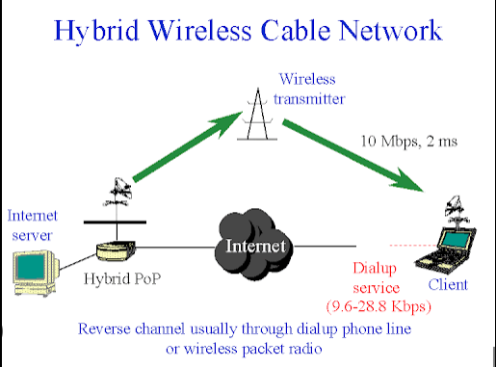

Slide 21
Hybrid Topology: Pros & Cons
Advantages
Disadvantages
Combines best features of different topologies
Complex troubleshooting
Highly scalable and adaptable
Higher hardware and design costs
Performance and security can be tailored

Slide 22
Feature / Topology | Infrastructure | Ad Hoc | Mesh | Star | Hybrid
Structure | Central Access Point | Peer-to-Peer | All nodes interconnect | Central device connects all | Combination of multiple types
Central Device Needed | Yes (e.g., router) | NO | NO | Yes (e.g., hub/router) | Depends on design
Scalability | Moderate | Low | High | Moderate | High
Reliability | Medium | Low | High (self-healing) | Low (if hub fails) | High
Complexity | Simple | Simple | Complex | Simple | High
Mobility Support | Moderate | High | High | Low | High
Data Routing | Centralized | Distributed | Dynamic/Decentralized | Through central node | Varies
Deployment Cost | Moderate | Low | High | Low | Medium-High
Examples | Wi-Fi networks | Mobile hotspot sharing | IoT networks, smart cities | Bluetooth devices, Zigbee | Smart campuses, military, 5G

Slide 23

Conclusion:
Wireless topologies play a crucial role in designing modern, flexible, and efficient networks. Each topology—whether infrastructure, ad-hoc, mesh, hybrid, or star—has distinct advantages and limitations. The choice of topology depends on factors such as the network size, purpose, environment, cost, and reliability needs. Selecting the right wireless topology improves network performance, coverage, security, and overall user experience. Understanding these topologies helps in building networks that are adaptable and resilient to changing demands.

